Slide 1

ST1504: Deep Learning CA1 Part B (Recurrent Neural Network)
By Lee Hong Yi, p2223010
(DAAA/FT/2B/07)

Slide 2

Introduction to task.
Objective:
To develop a model that predicts the next word in a sequence, using a provided dataset. The model should be able to generate creative and meaningful sequences of text based on input word sequences.
Background Information:
Language is a dynamic and complex system, with words often following predictable patterns. By understanding these patterns, a model can be trained to predict the next word in a sequence. This capability is fundamental in various applications such as text completion, chatbots, and creative writing aids. The objective is to create a model that not only predicts the next word but also can generate diverse and contextually appropriate continuations.
Additional Information:
The model should be capable of generating different outputs for the same input sequence.
The output should be evaluated for creativity and meaningfulness.
A comparison between the outputs of a trained model and an untrained model will highlight the importance of training in language models.
Output Variable:
The word that follows a given sequence of words, with the ability to generate extended sequences (e.g., ten words) based on repeated predictions.

Slide 3

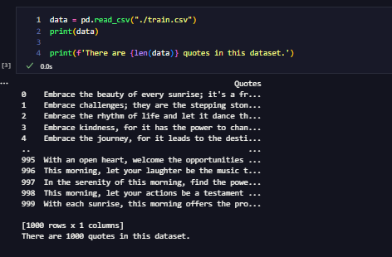
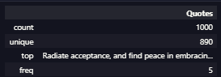
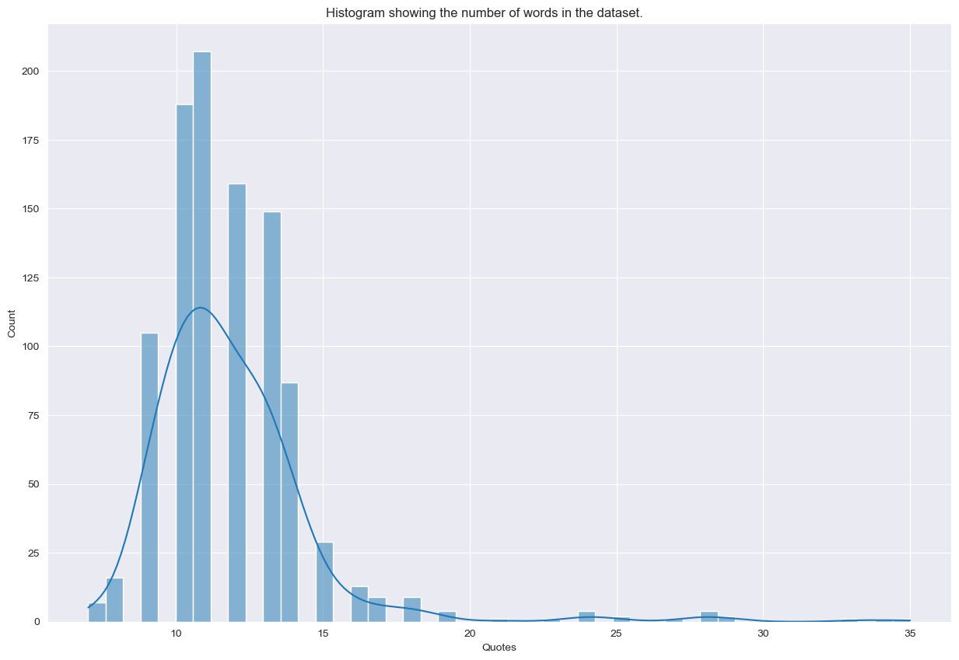
Exploratory Data Analysis
Since the data has already been collected for us, we just need to load it into Python.
We can see that there are duplicate quotes in the dataset. We shall remove this, leaving 890 unique quotes in the dataset.
From the above graph, we can see that the data appears to have a higher frequency at around 10 to 15 quotes, with a significant drop in frequency above 20.

Slide 4

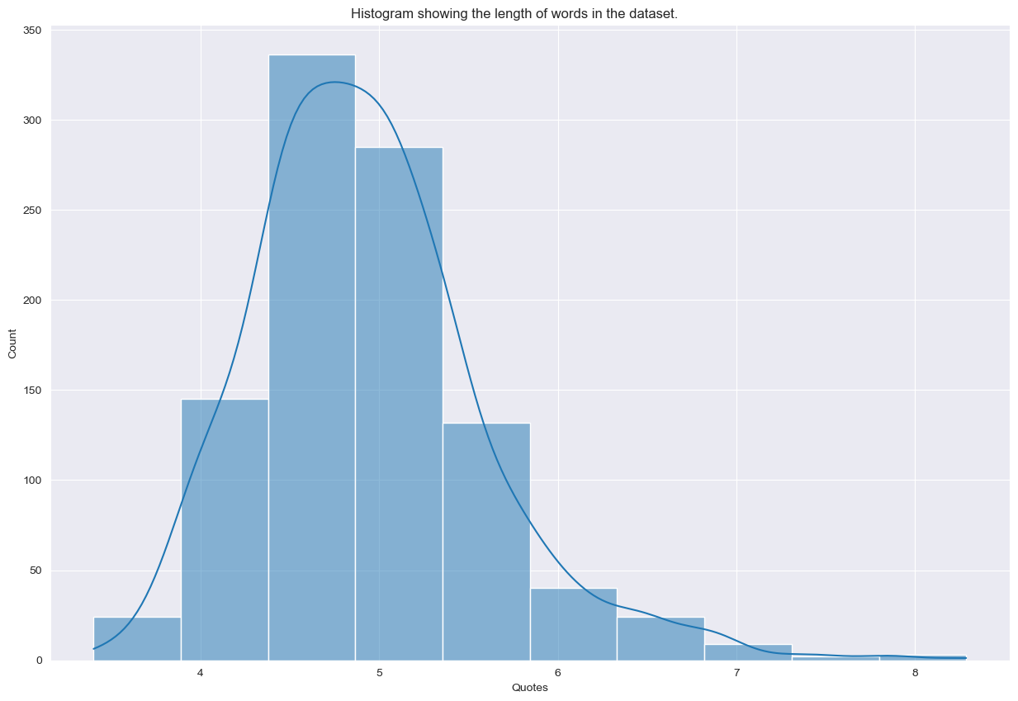
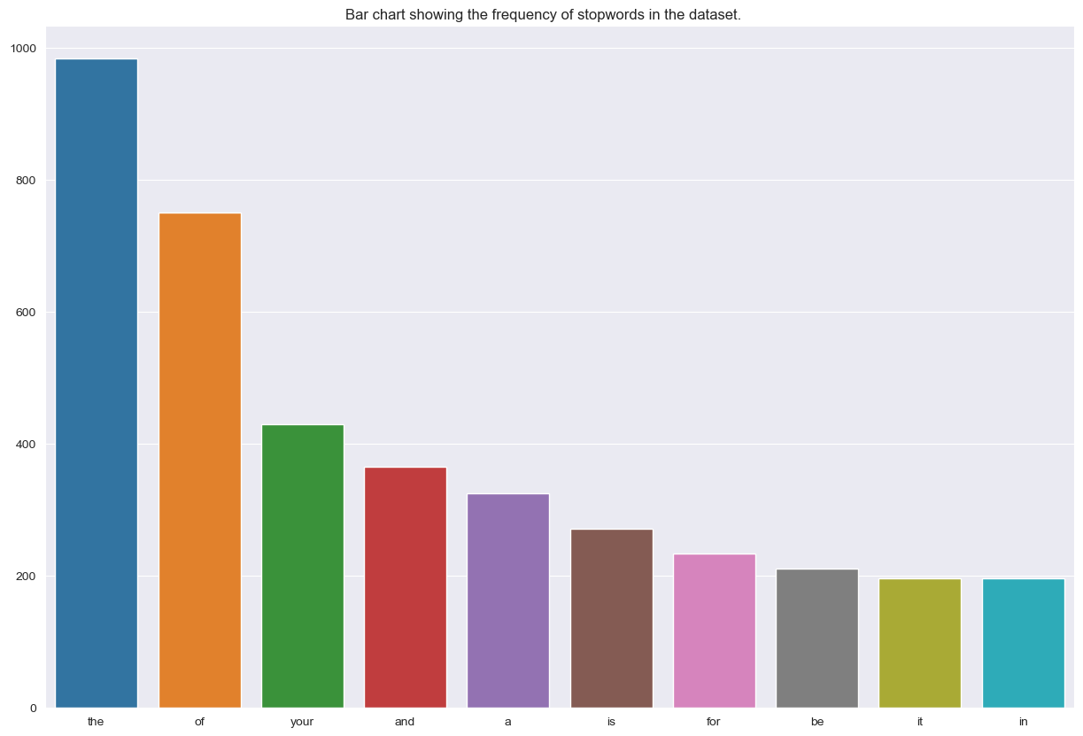
Exploratory Data Analysis
The average word length ranges between 3 to 9 with 5 being the most common length.
One reason why this may be is stopwords. Stopwords are the words that are most used in any language such as “the”,” a”,” an” etc.
As such words are usually short in length, these words may have caused the distribution to appear as such.
From the above graph, we can see that the words "the", "of", "your", "and", and "a" appear quite frequently.
Now that we know which "stopwords" appear the most frequently, we can now check out which less frequently used words are used frequently in the dataset.

Slide 5
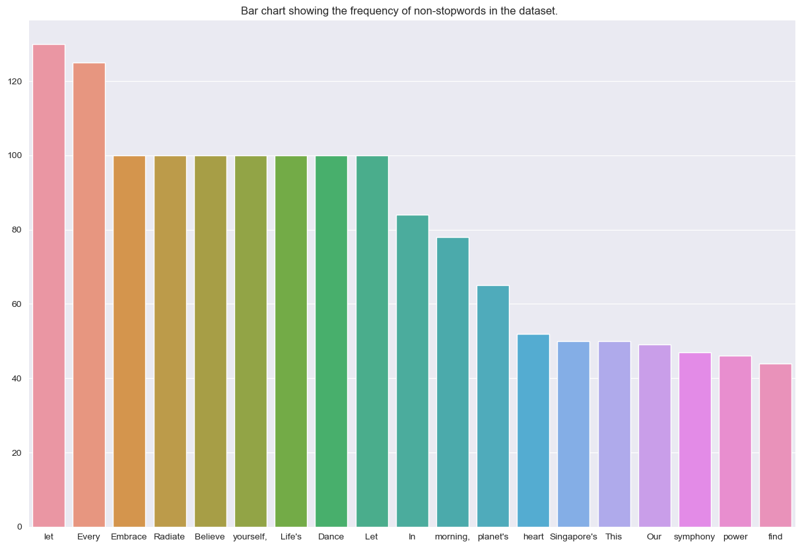
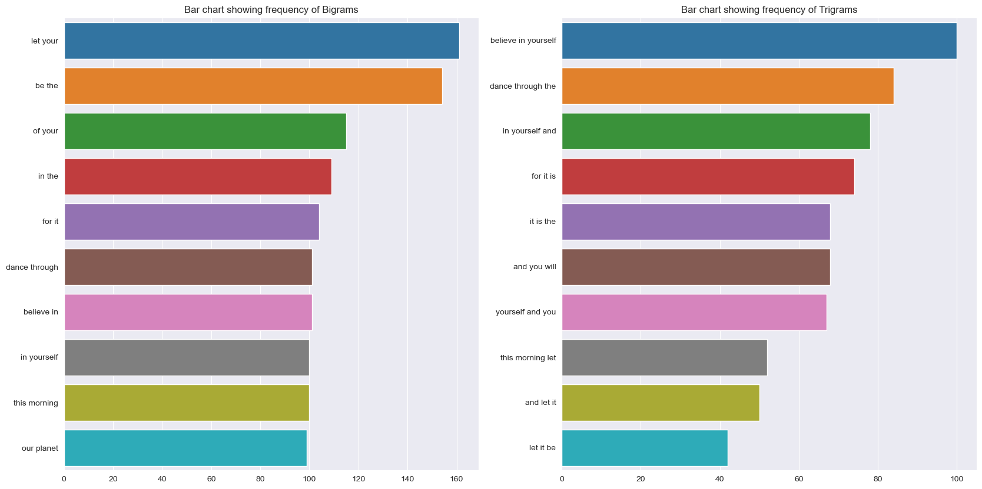
Exploratory Data Analysis
The average word length ranges between 3 to 9 with 5 being the most common length.
One reason why this may be is stopwords. Stopwords are the words that are most used in any language such as “the”,” a”,” an” etc.
As such words are usually short in length, these words may have caused the distribution to appear as such.
The above graphs indicates that words conveying inspiration, such as "let" and "every," dominate the dataset, with a cluster of words like "embrace," "radiate," and "believe" sharing common frequency. This implies that the text has an uplifting and motivational tone. Similarly, the prominence of stopwords like "the," "of," and "your" suggests these brief, common words significantly shape the dataset's profile, potentially overshadowing less frequent but more meaningful words.

Slide 6
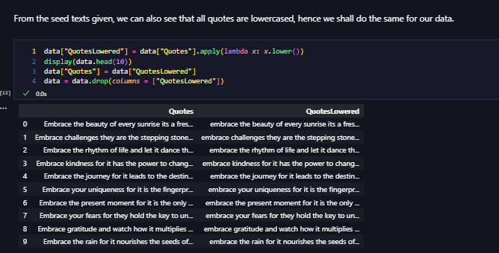
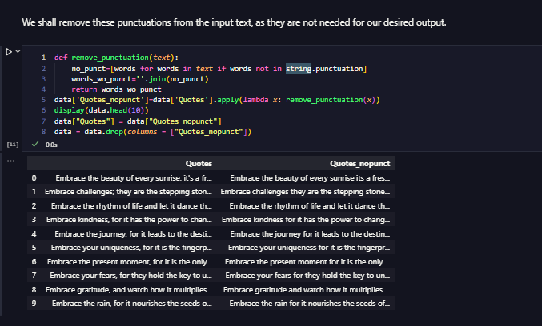
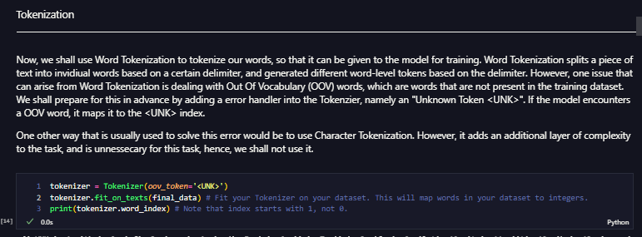
Data Preparation
To clean the data and get it ready for the model, we shall remove all forms of punctuation. We do this using Python’s string library. We also force the rest of the data to be lowercase and remove duplicates.
We shall tokenize the data as well, as the model can only take numerical data. We tokenize using tensorflow’s tokenizer, and add a <UNK> token, incase new words are encountered later on.

Slide 7
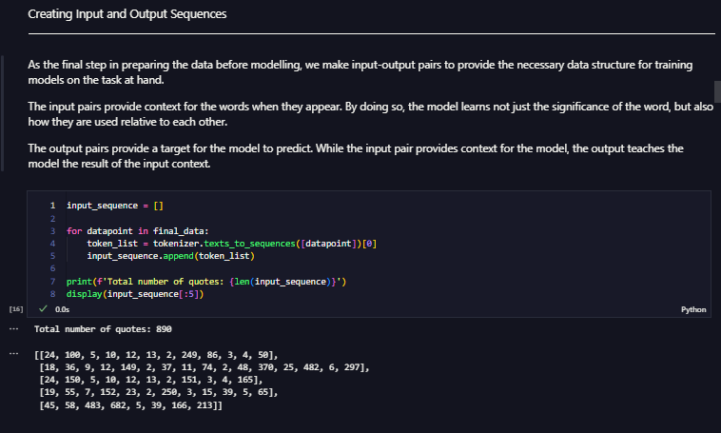
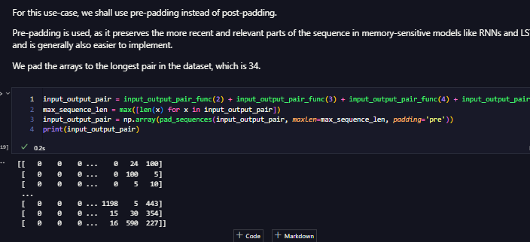
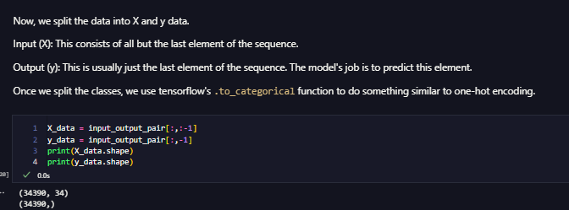
Data Preparation
We convert the data into input-output sequences, so that we can provide the data with the necessary data structure for training models.
We pre-pad the data, then split it into X and y data for the model to predict on.

Slide 8
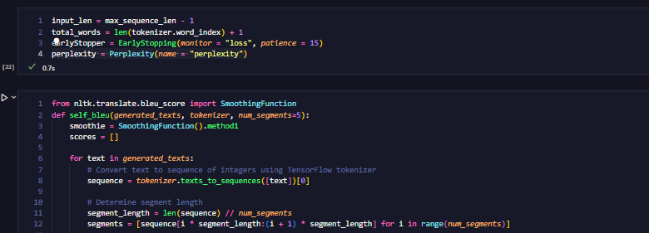
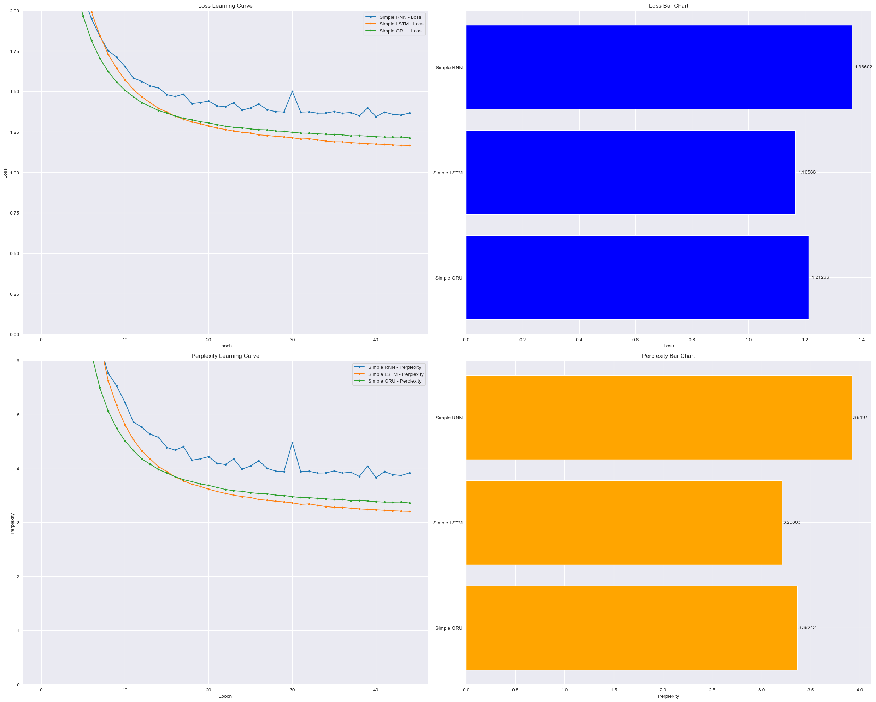
Initial Modelling
To carry out initial modelling, we shall use Sparse Categorical Crossentropy for our loss function, and Self-BLEU in combination with Perplexity to help judge the result of our models.
For our simpler models, we shall start with RNNs, then try out LSTMs and GRUs. We create a function to plot the loss and Perplexity curves, and then predict using the seed texts to view the results of the model.
From the initial modelling, we can see that LSTMs are the best performers out of all the simpler models, with GRUs coming in second, and RNNs being last, as expected.

Slide 9
Initial Modelling
For our more advanced models, we shall develop a Bi-Directional RNN. is a variation of the traditional RNN that improves its ability to understand context in a sequence. In a standard RNN, information flows in one direction, from past to future. However, there are many situations where the context of the entire sequence (both past and future elements relative to a certain point) is necessary to make accurate predictions or understandings.
Advantages: The main advantage of Bi-Directional RNNs is their ability to capture context from both directions of the sequence. This often leads to better performance on tasks where understanding the entire sequence is important.
Disadvantages: However, because they process the data in both directions, Bi-Directional RNNs are more computationally expensive than standard RNNs.
We shall use LSTMs for our Bi-Directional RNN as it was the best performer out of all the types of RNNs we tried earlier.
From our experimentation, we can see that the Bi-Directional RNN performs best with a single LSTM layer. We shall develop this further.

Slide 10
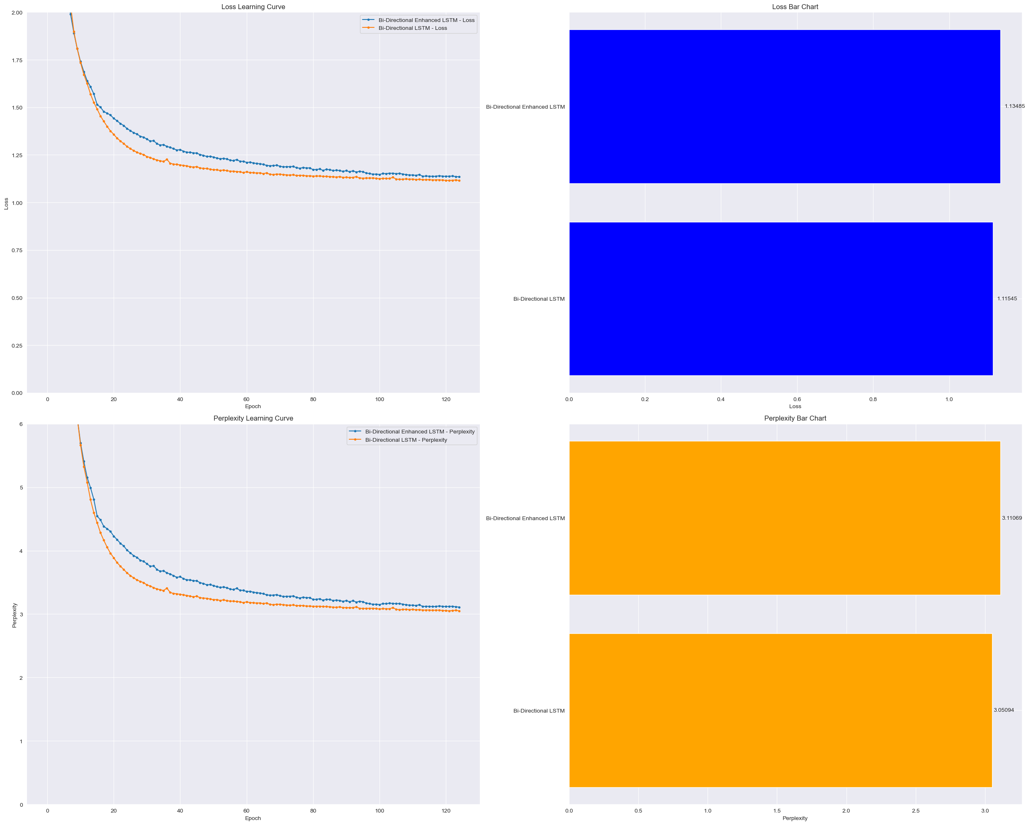
Model Improvement
To help us improve the performance of the model further, we shall increase the number of units in the LSTM layer, allowing it to capture more complex relationships in the data, making it more beneficial for tasks such as ours.
However, this more complex model is more prone to overfitting, especially due to the small size of our dataset. To combat this, we shall add a Dropout layer to the model to help us avoid overfitting.
After training our models against each other, we can see that the simpler model still performs better in terms of Loss and Perplexity. However, we can see that the enhanced model seems to be catching up to the base model.
Despite this, when looking at the generated texts, we shall go ahead with the base model, as the texts that it’s generates makes more sense than the enhanced model.

Slide 11
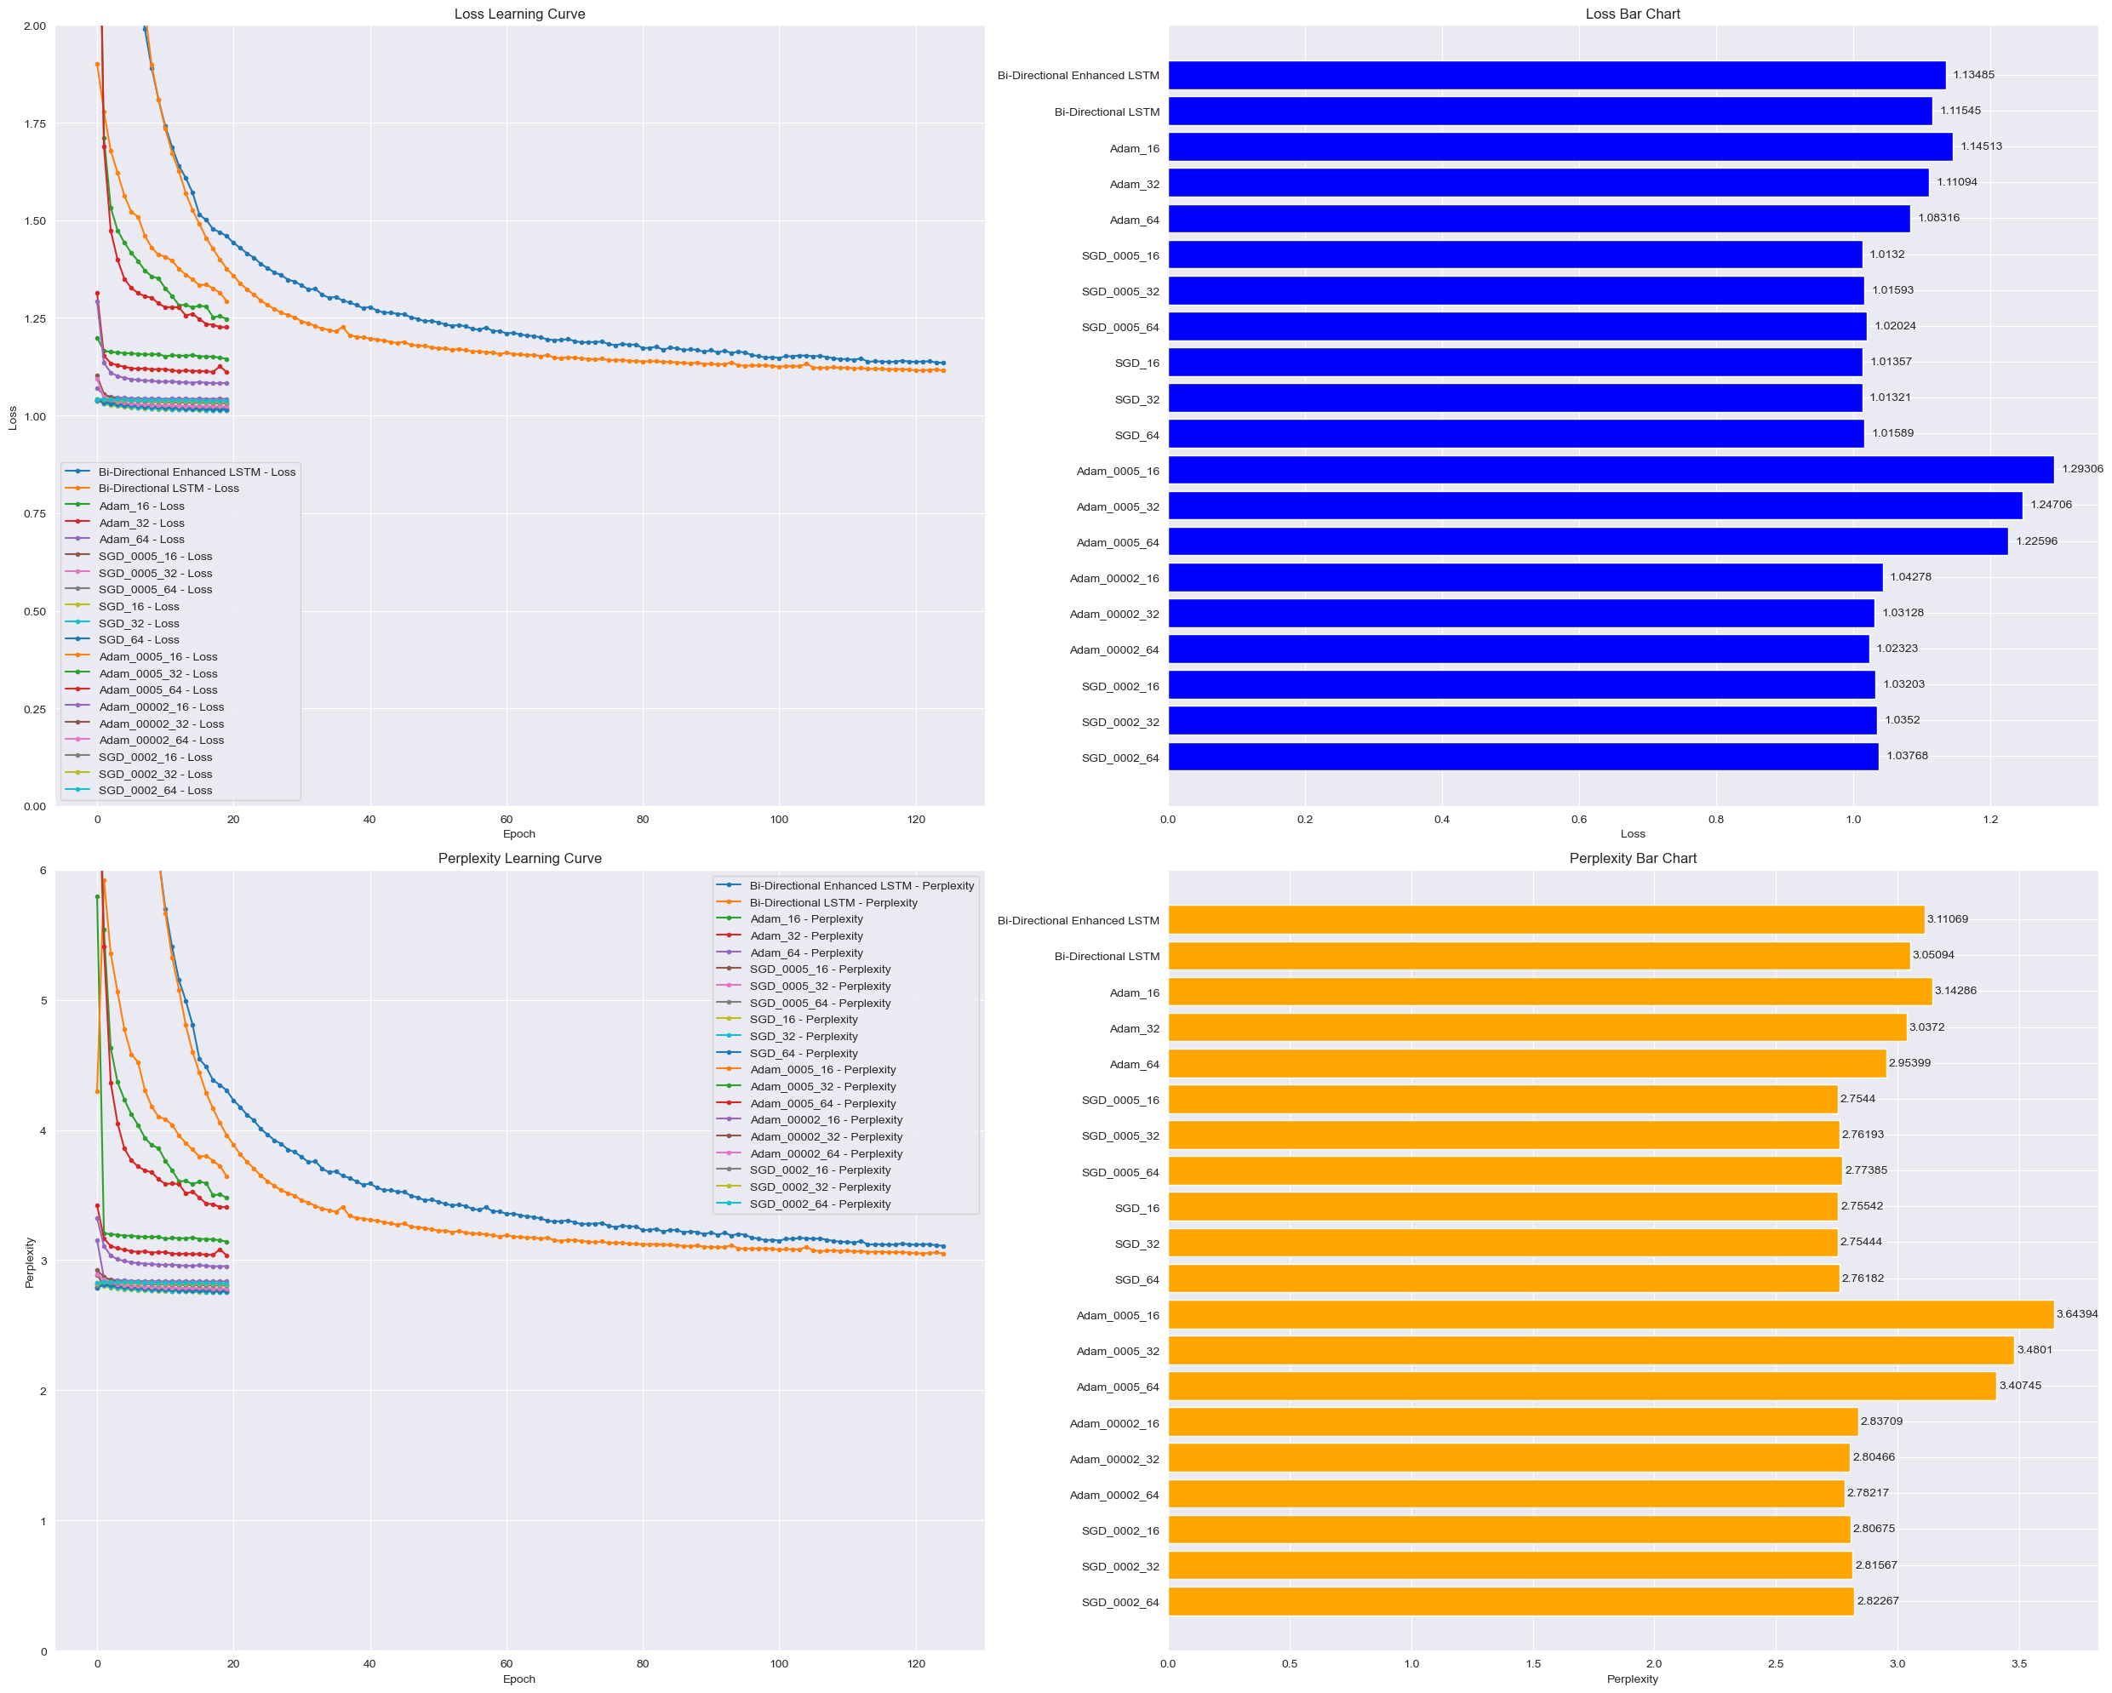
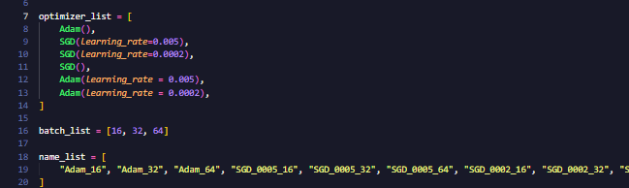
Hypertuning
For hypertuning, we make use of the Adam and SGD optimizers, and adjust the batch size of our input data as well.
From there, we create a function similar to scikitlearn’s GridSearch, to run over all possible permutations of the hyperparameters to obtain the best possible values for the model.
From the results, we shall pick the best performer metric-wise, and the worst, and compare their texts. This is to check that the model has not overfit, and is still able to generate coherent text.

Slide 12
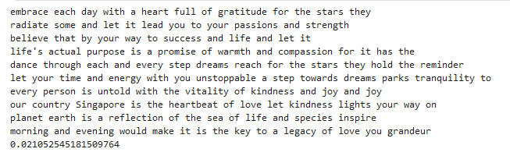
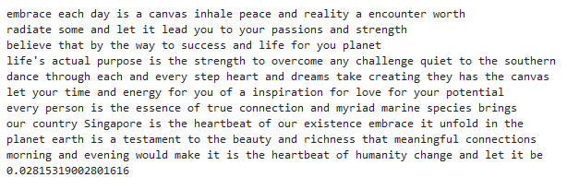
Final Evaluation
Conclusions
For our final model, we shall pick the Bi-Directional LSTM model, compiled with the SGD optimizer, with a learning rate of 0.005, and fitted using data batched with a batch size of 16.
This exercise was a interesting one, providing us a insight into how a RNN tool can be developed.
There were several things that I would like to have attempted for this assignment, such as Attention to further enhance the "memory" of our LSTM models, as well as carrying out character based predictions, along with longer predictions to test the robustness of the model. However, I could not attempt it for this assignment due to several limitations.
Despite this, it was quite interesting attempting to create a next-word predictor, and we can see the fruits of our labour.

